Slide 1

Sales Dashboard
Surekha Berlin

Slide 2
Problem statement
An ABC company has the sales data for the last 3 years and they want to analyze it now. Based on the data set given, try to create a dashboard.
Include important KPIs
Sales over Time
Sales for various Products
Manager wise analysis
Customer coverage across different Locations
Target Analysis

Slide 3
What is a Sales Dashboard?
A sales dashboard is a tool designed to provide sales teams with a comprehensive, real-time view of their performance by visually displaying key sales metrics and data.
The dashboard provides an at-a-glance view of your sales team's performance. Sales teams operate in a fast-paced, target-oriented environment. Data-driven sales managers and reps closely monitor their individual and team performance daily so they can adjust or improve their strategies in real-time.

Slide 4
How to create Sales Dashboards
All dashboards are built on the principle of pulling sales data into the platform and providing the sales reps with a visual representation of that data. Here’s a simple checklist for creating a sales KPI dashboard:
Identify the sales metrics and KPIs you need to monitor to make data-driven decisions
Identify where that data currently resides (CRM, Excel, Google Sheets, HubSpot, Salesforce)
Determine how you want to view your dashboard (TV dashboard, mobile, or desktop dashboard)
Evaluate a dashboard software vendor based on your requirements
Pull data from your data services into the dashboard
Choose appropriate visual representations for your dashboard
Share the dashboard with your team and sales executives to encourage the adoption

Slide 5
What is a sales target?
A sales target is a specific goal or objective set by a company or individual for the number of products or services they aim to sell within a given time. Sales targets are often used to track performance and motivate sales teams. Targets can be set by revenue, units sold, or customer acquisition and are adjusted based on market conditions. Achieving sales targets is critical for a company's success and can impact revenue, profitability, and market share. Sales targets can also be used to evaluate performance and incentivize sales personnel.

Slide 6
Sales Target Attainment Formula
(Sales for the current period/Sales target)x100

Slide 7
DATA VISUALIZATION in power bi

Slide 8
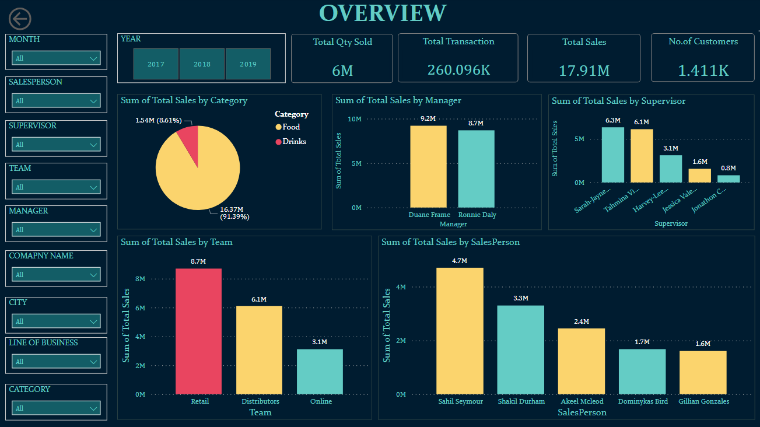

Slide 9
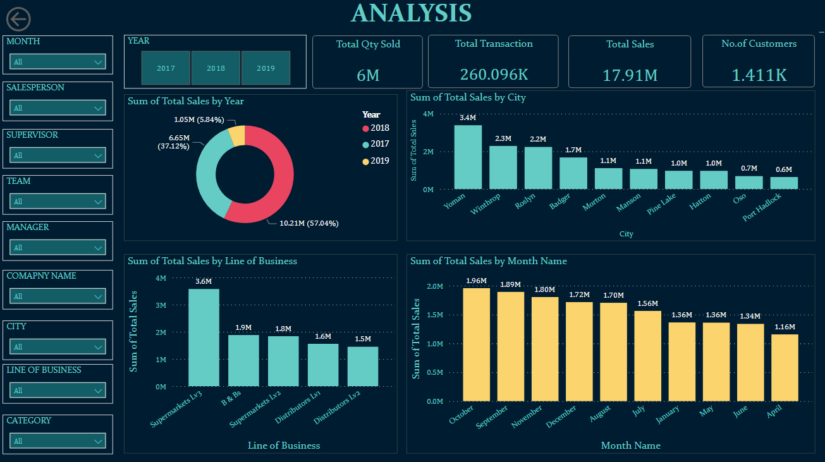

Slide 10
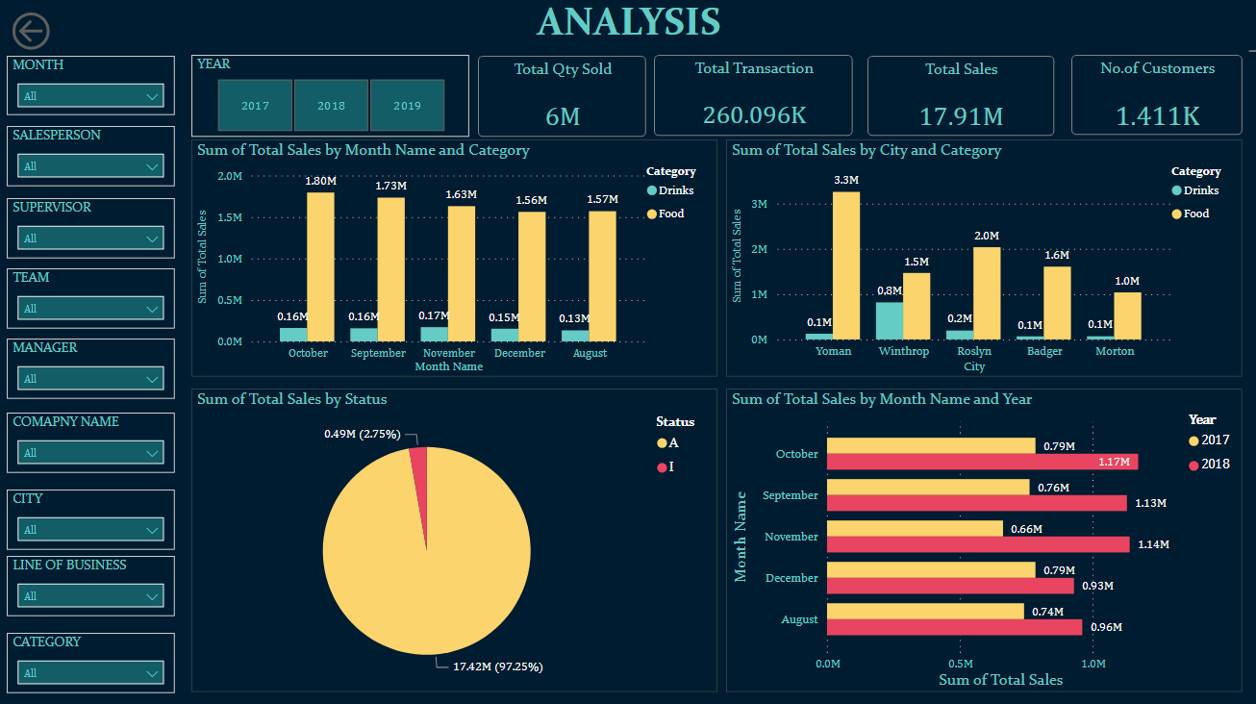

Slide 11
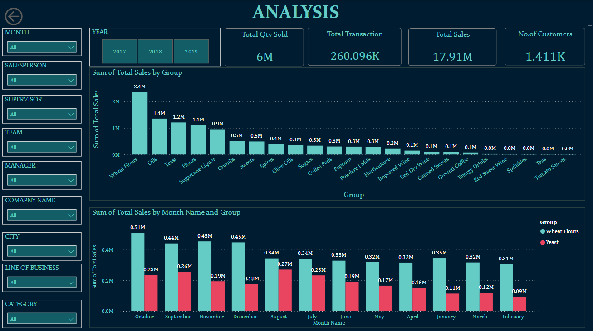

Slide 12
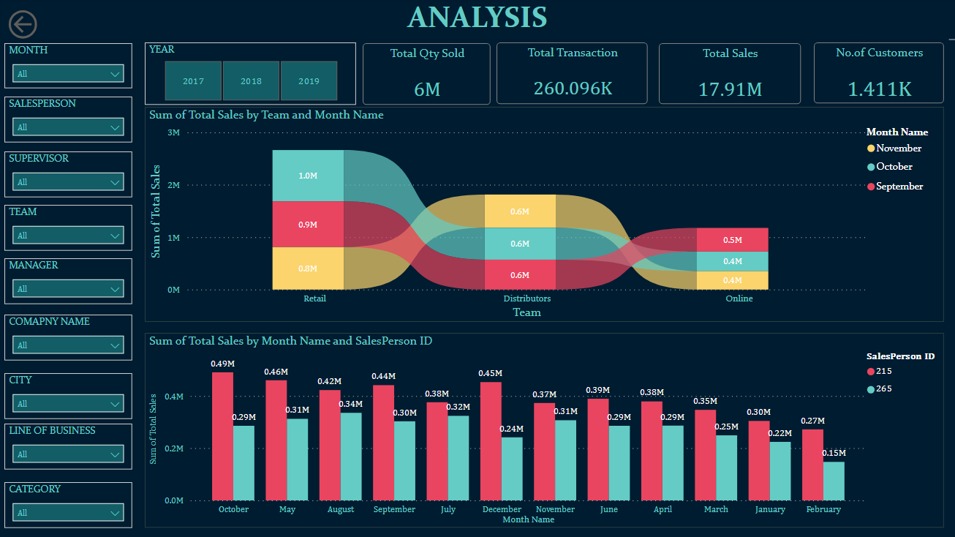

Slide 13
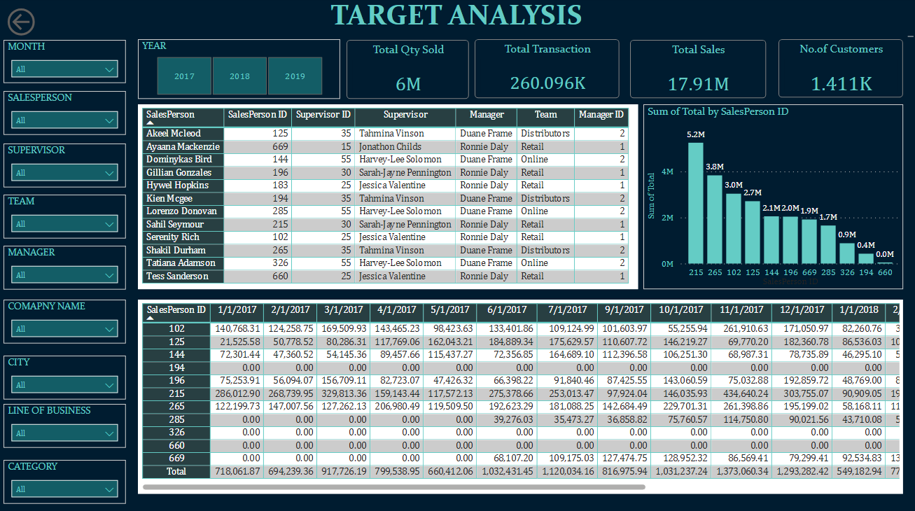

Slide 14
FINAL INSIGHTS
1. Total Sales of Food is 16.4M and Drinks 1.5M
2. Highest Sale was made in 2018 (10.2M),2017(6.65M) and 2019(1.05M)
3. Manager Duane Frame made sales of 9.2M and Manger Ronnie Daly made 8.7M
4. Salesperson with top sales is Sahil Seymour 4.7M
5. Retail team made more sales 8.7M and less sales was made by online team 3.1M
6. Supervisor with more sales is Sarah Jayne 6.3M
7. The line of business with more sales is Supermarkets LV3
8. The city with more sales is Yoman 3.4M, Winthrop 2.3M and Roslyn 2.2M
9. Month with more sales is October 1.96M, September 1.89M and November 1.8M
10. Wheat Flour made more sales of 2.4M then Oils made sales of 1.4M and Yeast made sales of 1.2M
11. 97.25% of sales was made by customers with status A

Slide 15
THANK YOU

